Slide 1
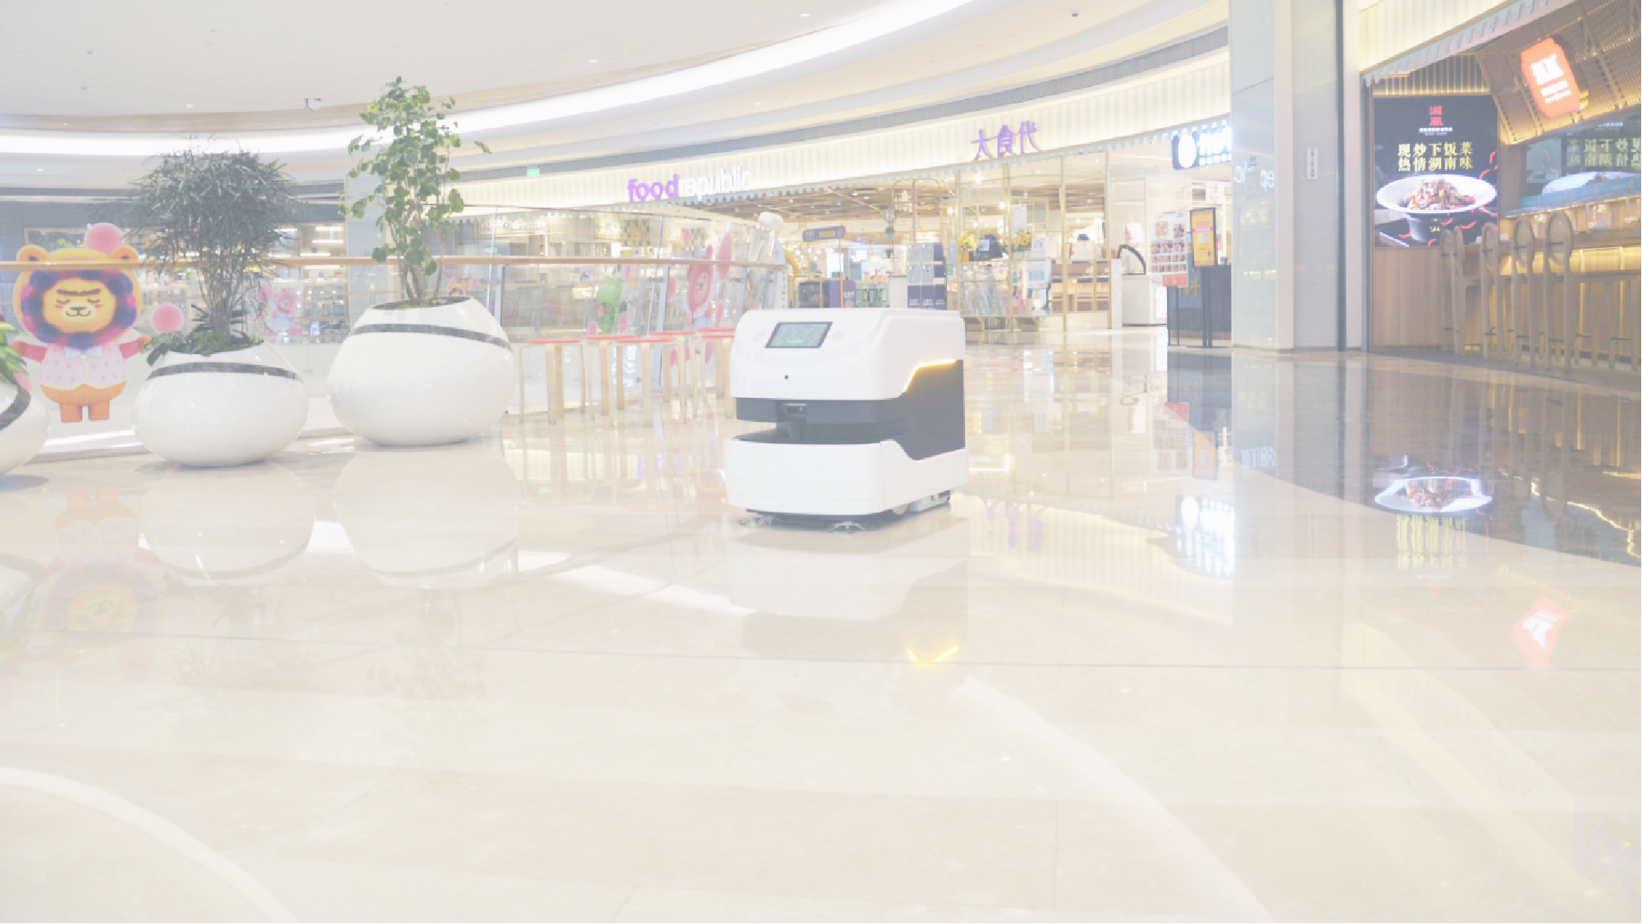
Snail sweeper cleaning robot
Snail sweeper cleaning robot，replacing labor with robots, reducing the difficulty of ground cleaning, improving cleaning efficiency and quality, Easily competent in various complex large scenes.
2021.05
www.reeman.cn

Slide 2
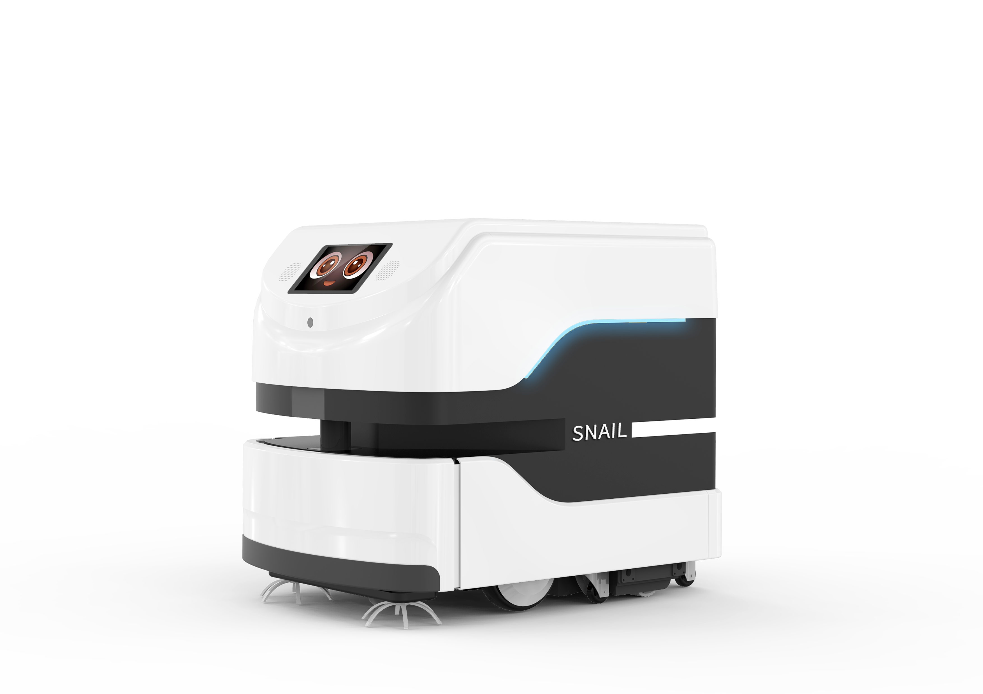
1.1 Product description
Snail sweeper cleaning robot automatically perform mopping tasks through unmanned driving technology, relying on mature SLAM robot autonomous positioning and navigation technology, lidar + 3D camera + ultrasonic + optocoupler anti-collision design, etc., precise navigation and positioning, providing smarter and more environmentally friendly The cleaning service supports the setting of timed cleaning tasks, replacing labor with robots, improving cleaning efficiency and quality. The large laser area of 40,000 square meters can easily handle various complex large scenes. It has obvious advantages such as simple operation, comfortable use, high efficiency and fast speed. , Becoming the new favorite of large-scale commercial establishments, hospitals, hotels, high-speed railway stations and other fields.
1
Mopping
Vacuuming
Sweeping the floor
Built-in mopping module, absorb dust, lock water and wet mopping,
Mop and dry without leaving water stains
3
2
Energy saving
The water circulation system can reuse water,No need to
add water frequently
UVC lamp disinfects the ground
16 watt UVC light irradiates the mopping module to directly disinfect the ground

Slide 3
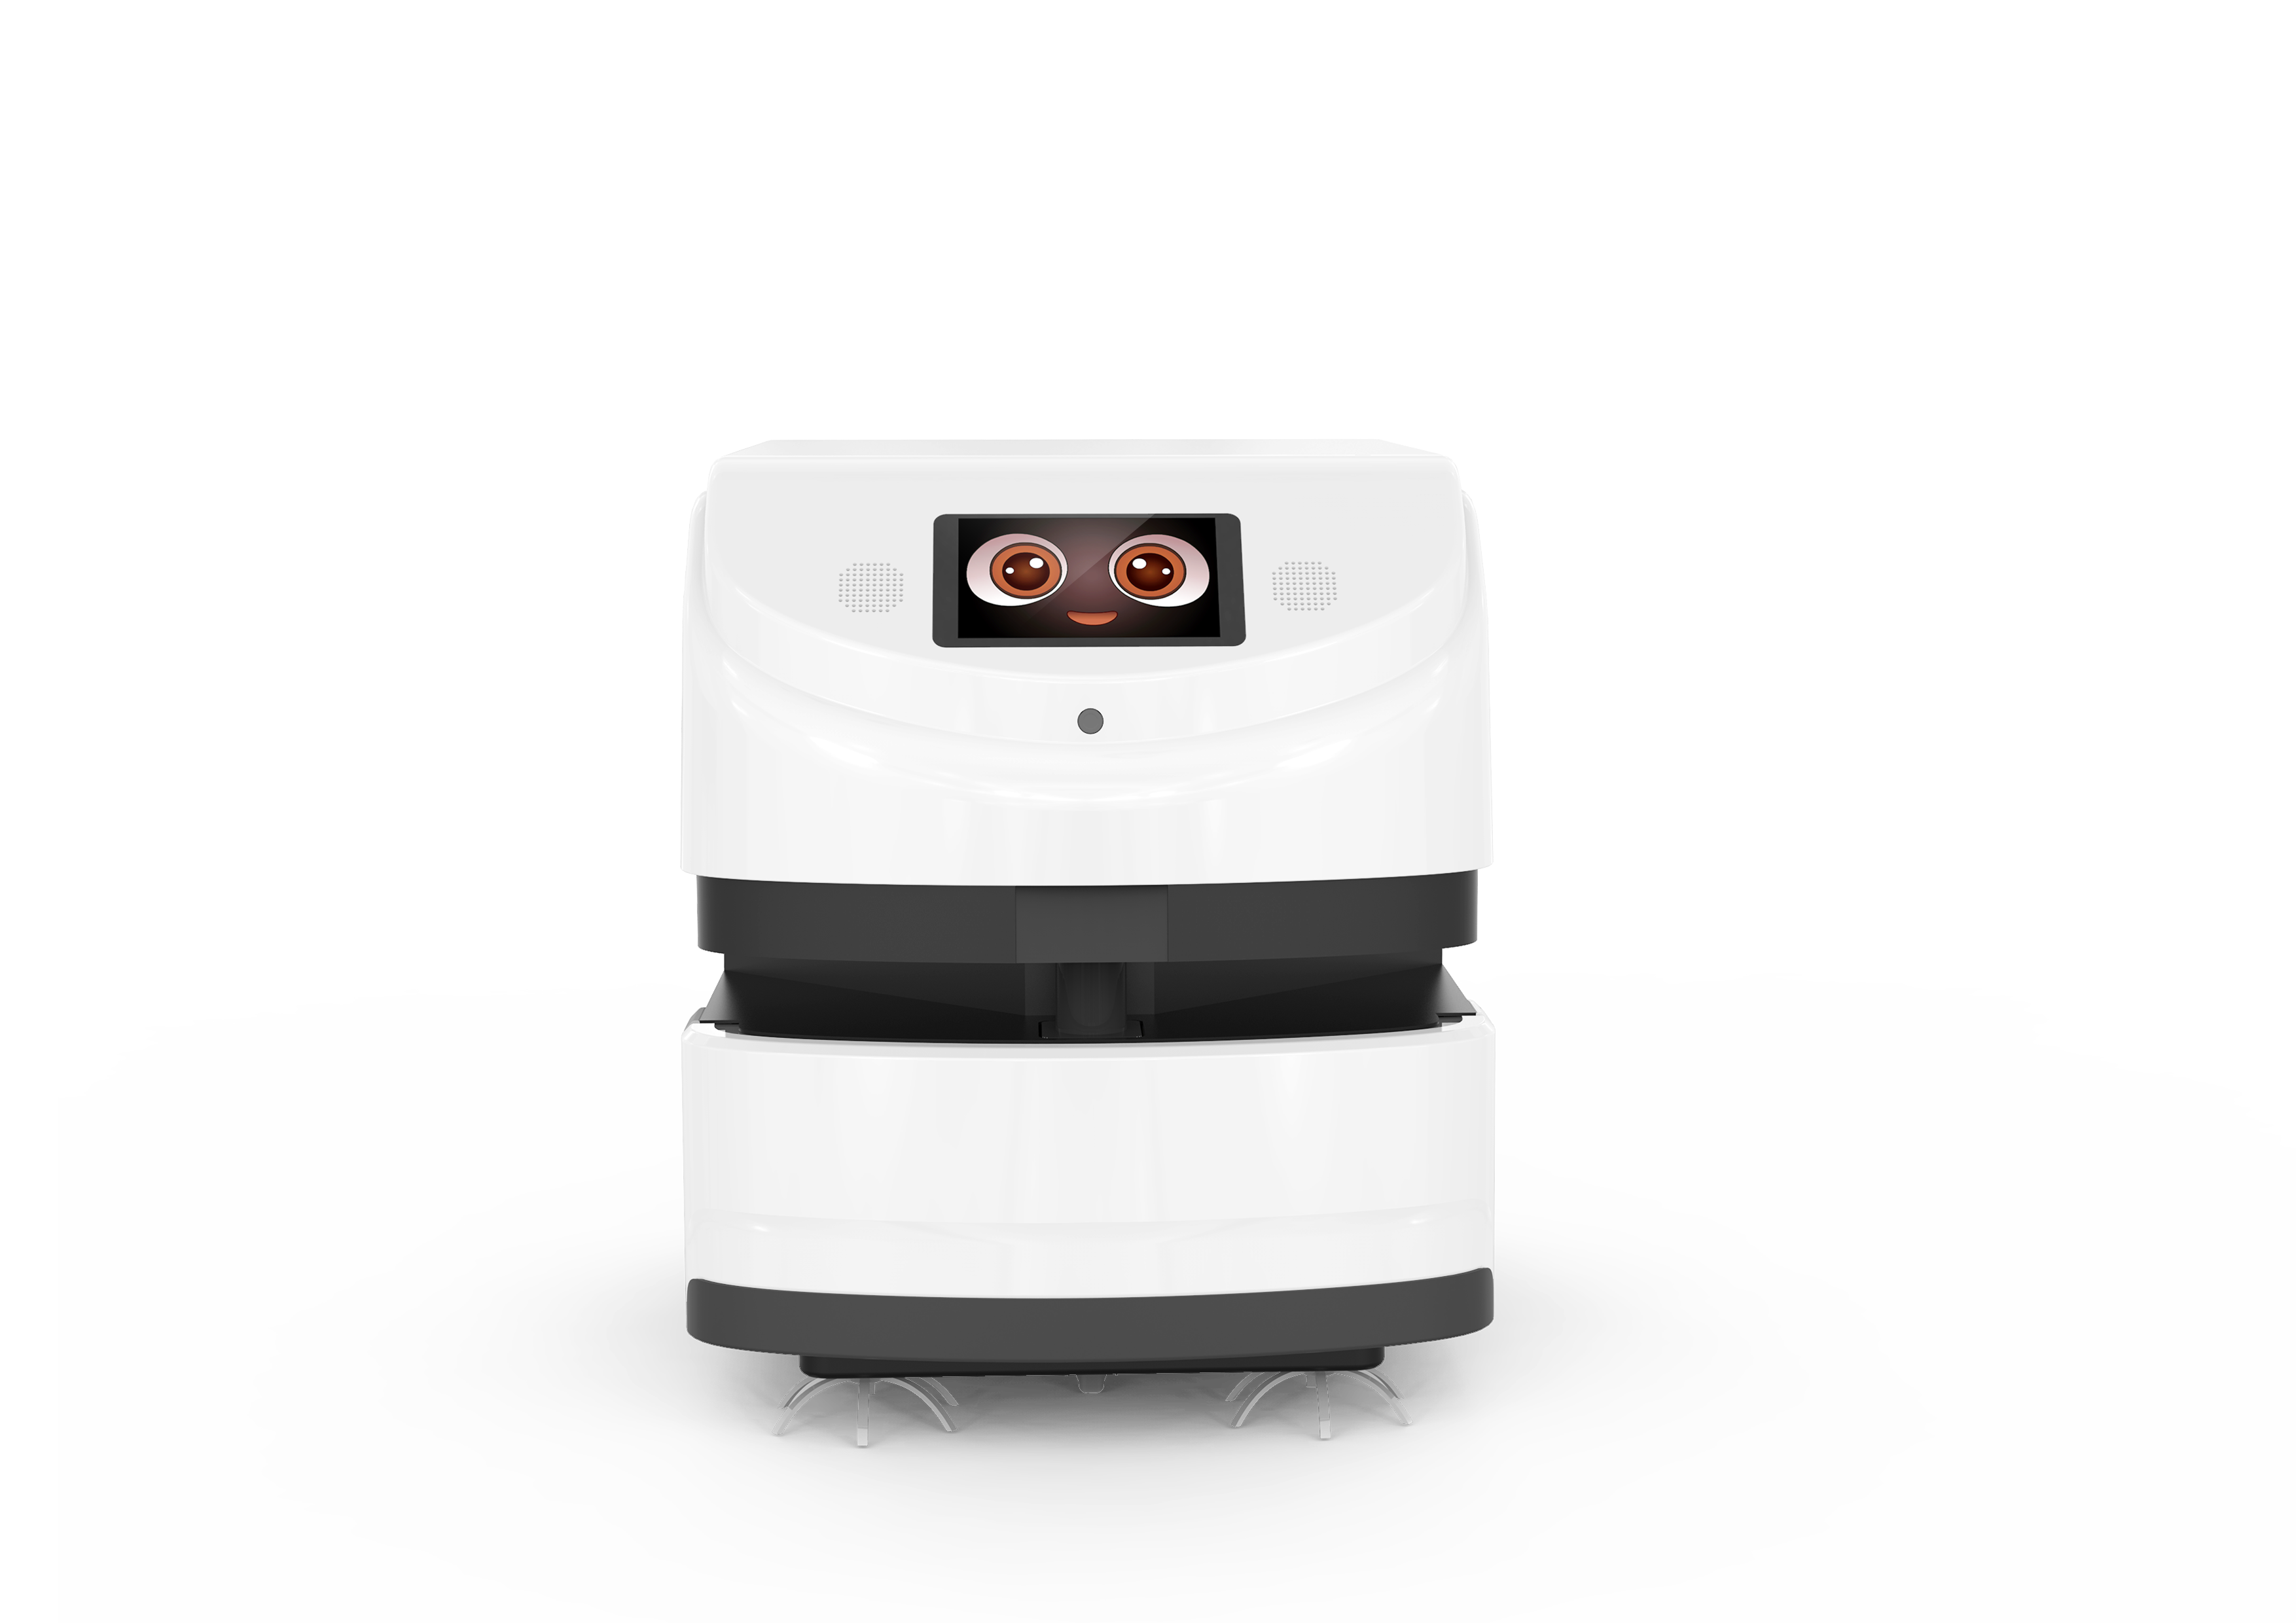
1.2 Product Features
Timed tasks
Set cleaning time and location
in advance
Automate cleaning tasks
Water disinfection filtration system
Automatic filtration and disinfection, energy saving, environmental protection, time saving and high efficiency
40,000 ㎡ super large
laser mapping
Laser SLAM mapping technology, Optimized navigation algorithm,
Can be used in large scenes
Remote navigation deployment
Build navigation maps remotely, saving time and efficiency, convenient and fast
Automatic return to charging
If the battery is below the minimum value, it will automatically return
to the charging station for charging
Autonomous obstacle avoidance
Multi-sensor collision avoidance and obstacle avoidance system (3D camera, laser, optocoupler anti-collision system)

Slide 4
1.3 Product features
Smart reminder
Energy saving
· The bow shape is clean along the wall, no repetition, full coverage
· Original cloud service management platform, remote navigation deployment,
time-saving and efficient
· Support multi-task cross-area cleaning, (same map, same floor)
· Unique water disinfection filtration system, automatic filtration, saving water
resources
· Timed appointment function, automatic cleaning, no time limit
· Laser SLAM high-precision navigation and positioning
· Lidar + 3D camera + optocoupler anti-collision design, safer operation
· Cleaning speed 0.1~0.5m/s (speed adjustable)
· Convenient pull-out mopping module design simplifies work and is convenient
for cleaning and maintenance
· 40,000 ㎡ of super large laser mapping to meet the use of large scenes
· 25Ah/38.4V lithium iron phosphate battery, 9 hours of long-lasting battery life
· Low battery will automatically return to charging, no one will operate
· Intelligent reminder function for equipment maintenance, failure, and
replacement of consumables
Friendly to the ground
UVC
disinfection
Automatic charging
Automatic obstacle avoidance

Slide 5
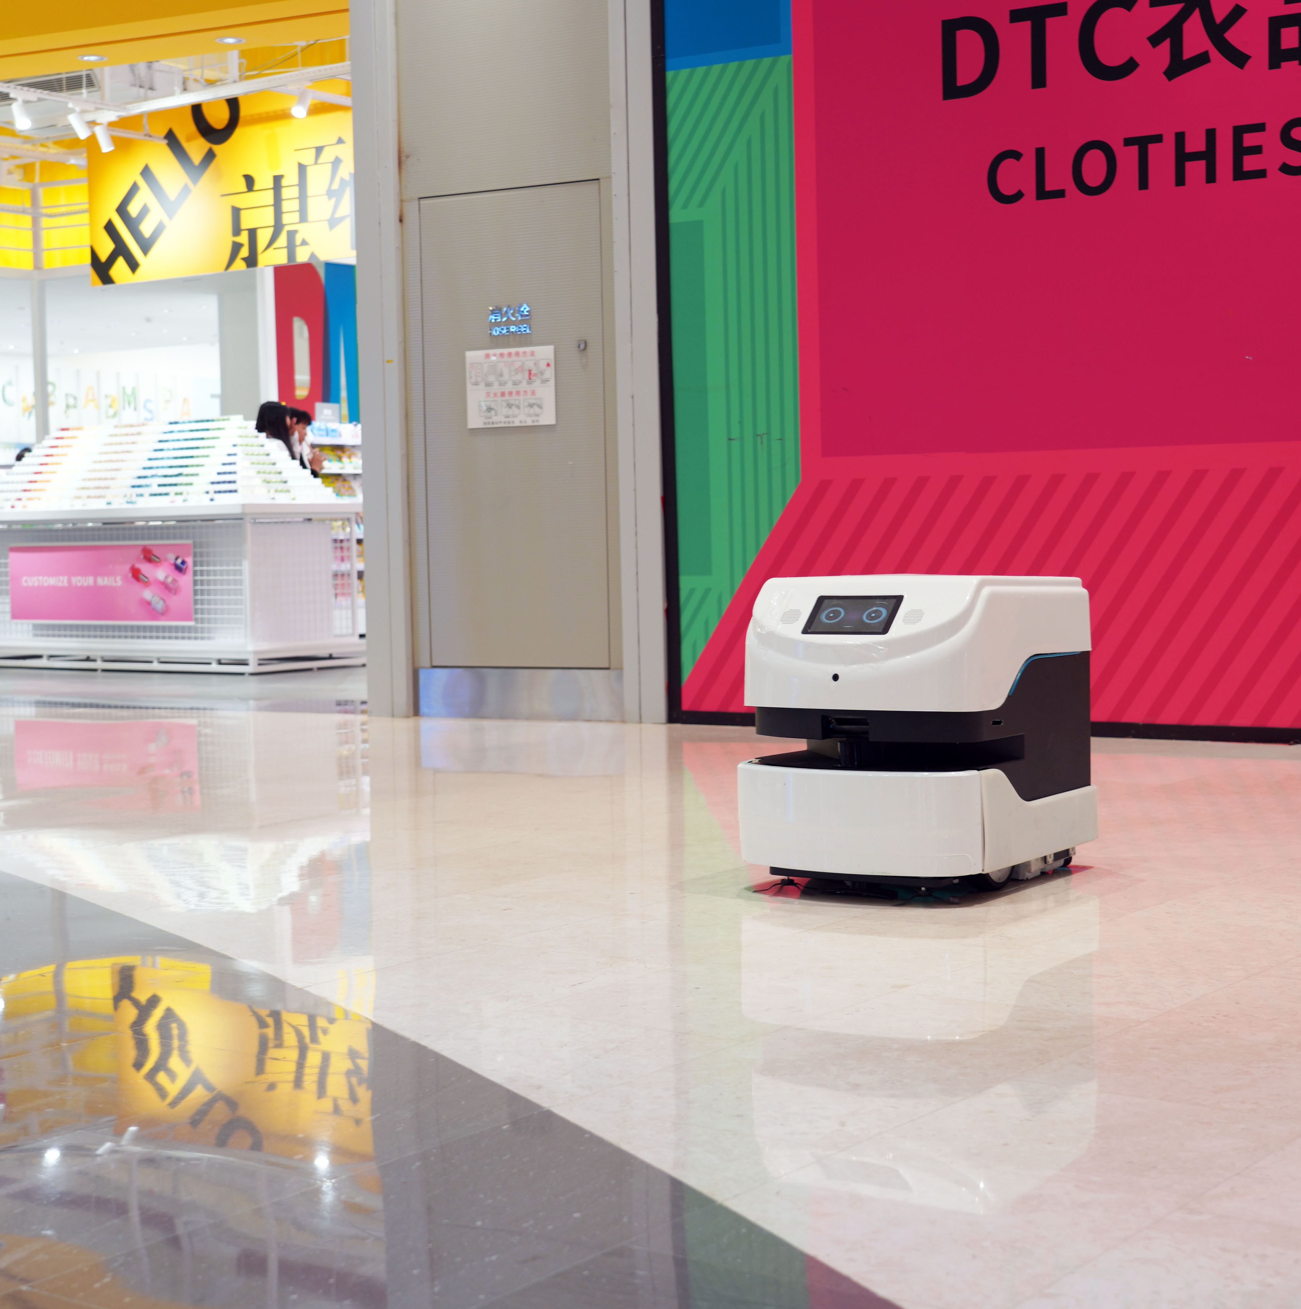
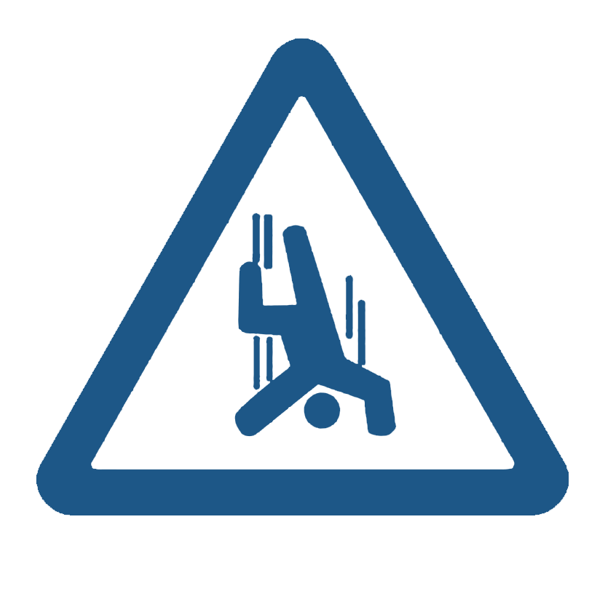
1.4 Working principle
“弓”Walking path
Intelligent obstacle avoidance
Anti-drop
Use optimized algorithms to
achieve clean and full coverage
3D camera, lidar, optocoupler anti-collision system,
multiple anti-collision design, stable and safe operation
Accurately detect dangerous roads and make detours to
prevent the robot from falling
Remote intelligent control
Automatic return to charging
Indoor navigation and positioning
Unique cloud service platform, remote assistance to build
navigation maps, remote
viewing of machine operating data
Low battery automatically
returns to the charging
pile for charging without
human intervention
Obtain environmental
information through lidar
sensors for positioning and
navigation.

Slide 6
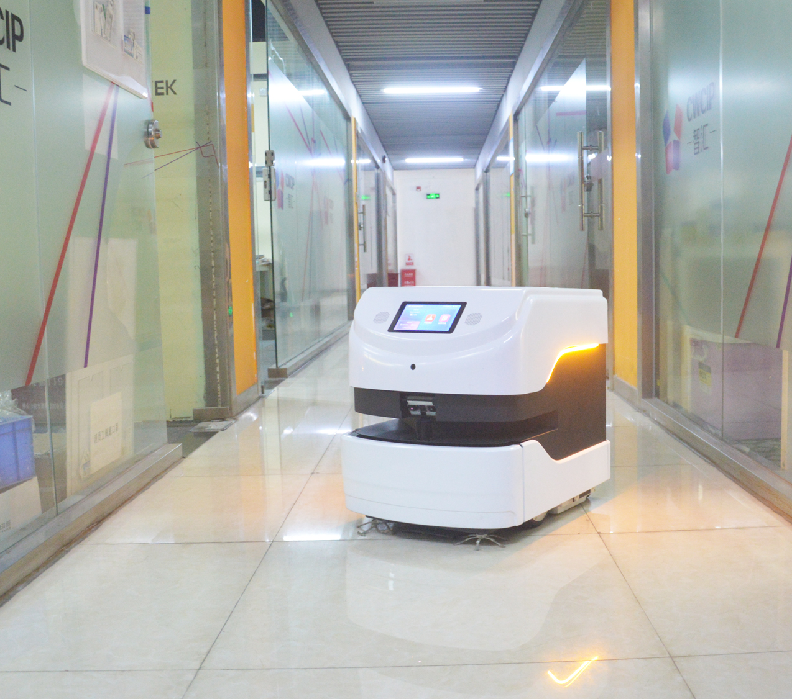
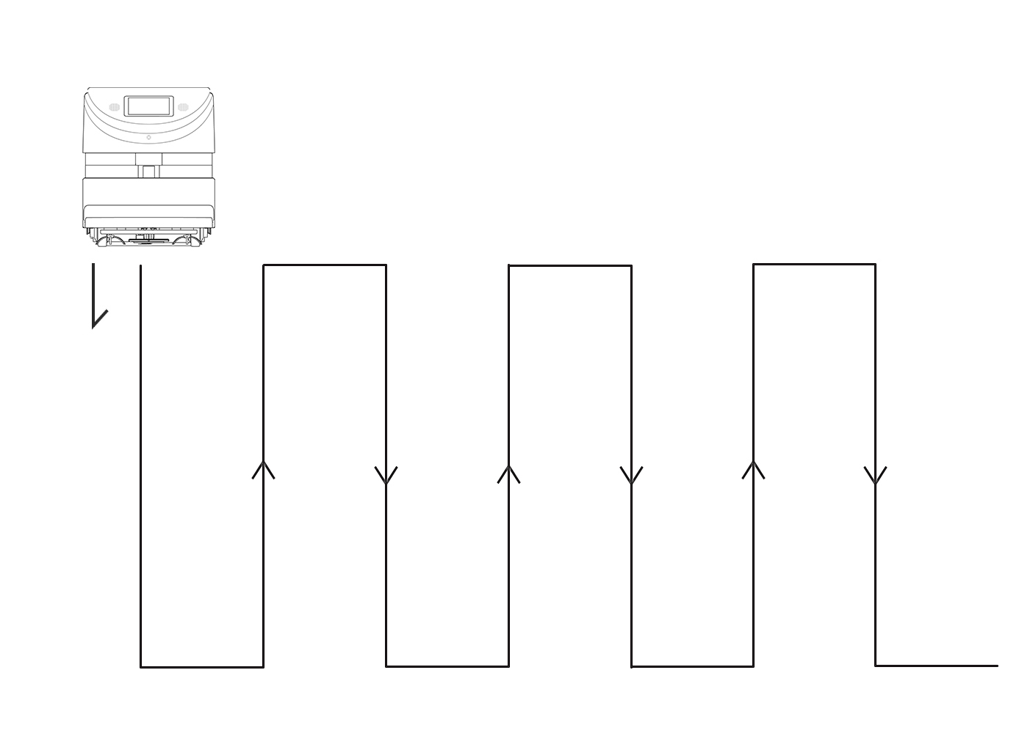
1.5 Principle of cleaning
The three-in-one design of mopping, vacuuming, and sweeping, independently planning the cleaning path, mopping along the wall in a bow shape, has a more complete coverage, and solves the cleaning problems of ground water stains, stains, dust, and paper scraps.
The 386mm wide absorbent sponge roller is made of a special polymer absorbent material, which will not damage the ground when mopping the floor, and it will dry when mopping, meeting the requirements of floor cleaning in many industries.
The built-in 16-watt UVC ultraviolet lamp can disinfect the mopping module and the ground, making it more hygienic for aseptic mopping. (Open the lid and automatically turn off the lights to avoid injury)
Working principle: The roller brush effectively rolls up the ground garbage (such as paper scraps, melon seed shells) through physical transmission, and automatically sucks into the vacuum box inside the robot. It has a built-in water circulation filter system. The water-absorbing sponge roller moppes the ground. The robot background is real-time. Display data such as positioning, power and mileage.
“弓”Walking path
Mopping roller width: 386mm speed 0.1~0.5m/s
Running direction

Slide 7
2.1 Water circulation filtration, UVC ultraviolet + ground disinfection
UVC
15L water tank
Water circulation filtration, saving energy
UVC ultraviolet disinfection ground
Reduce the frequency of adding and changing water
Snail sweeper cleaning robot adopts a large 15L water tank, an original water circulation automatic filtration system, purifies sewage, reduces the frequency of water exchange, and saves water resources. The floor disinfection with 16-watt ultraviolet lamp tube, mopping and floor disinfection are carried out at the same time. Supports 40,000 square meters of large-area map construction, meeting the cleaning needs of various occasions, and can replace manual ground cleaning tasks in high-risk environments.

Slide 8
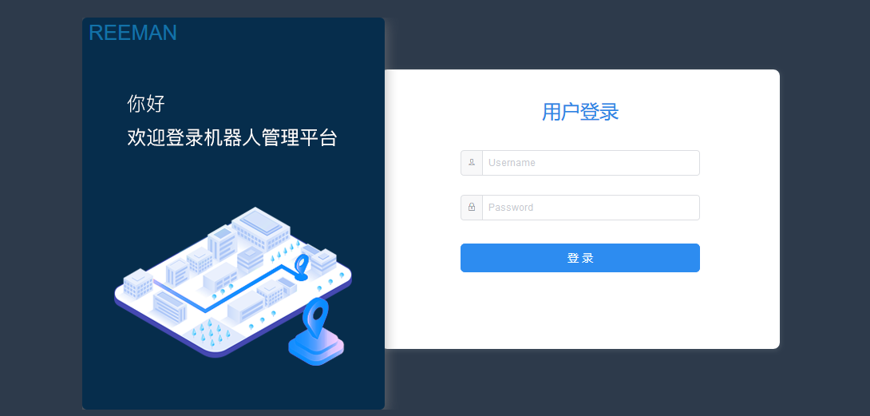
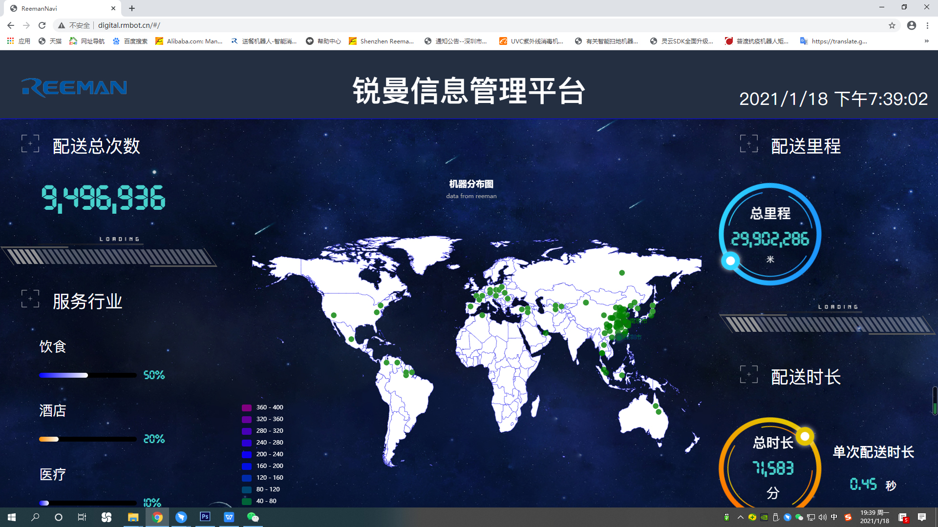
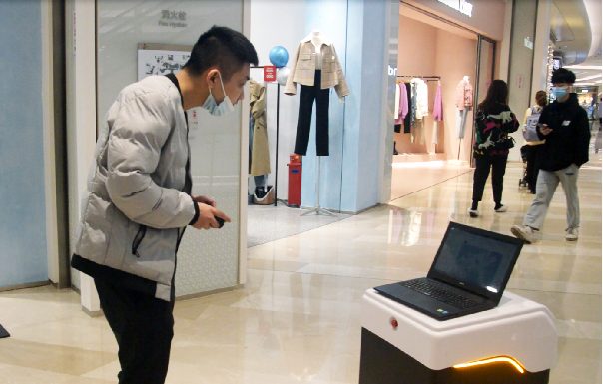
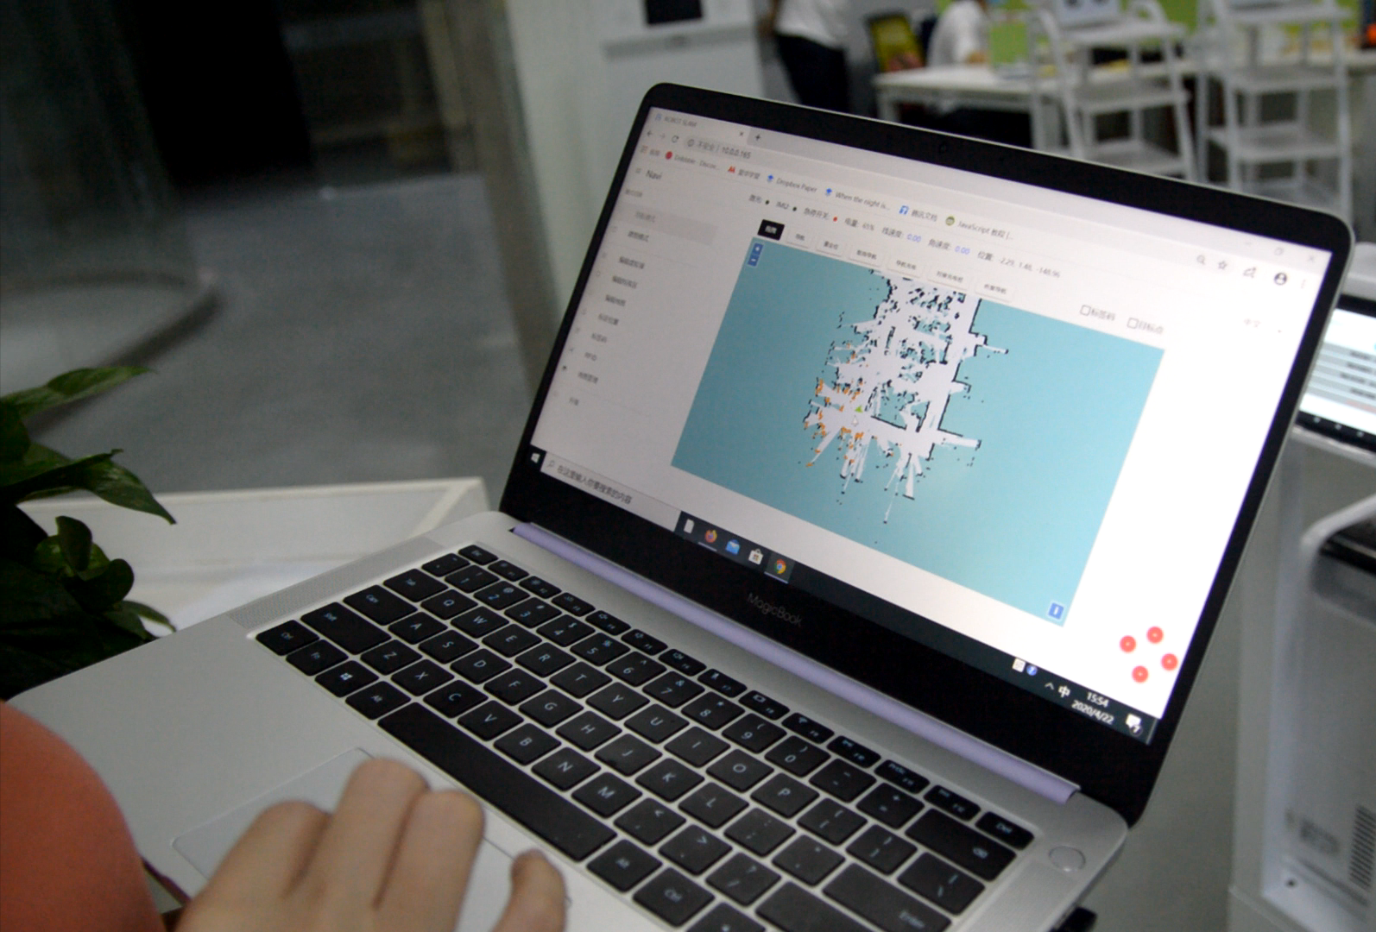
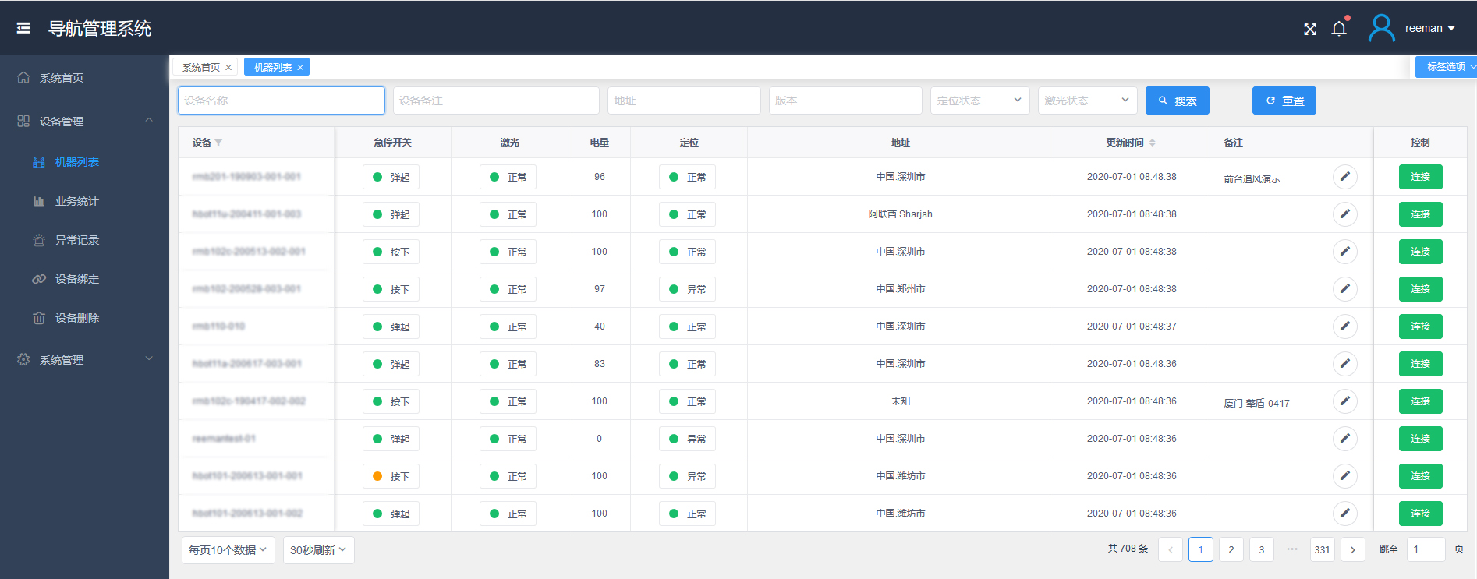
2.2 Remote navigation deployment
Navigation map
Edit map
Through the cloud service platform, the robot is connected and controlled remotely, and the navigation map is constructed visually throughout the process, reducing the response time of operation and maintenance services, allowing the robot to be put into use in a shorter time, saving time and cost.

Slide 9
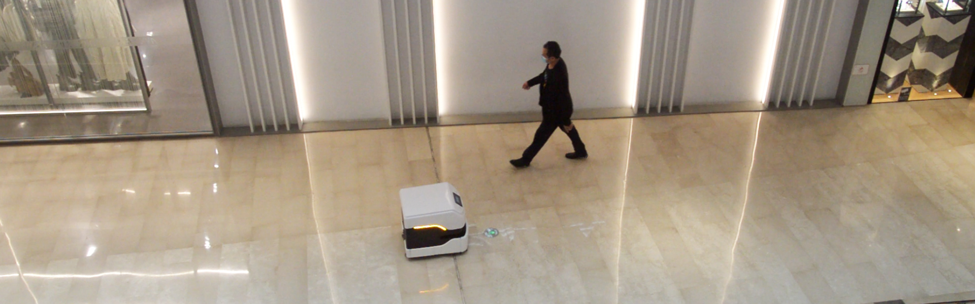
2.3 Multi-sensor collision avoidance and obstacle avoidance system
(Intelligent planning path + autonomous obstacle avoidance + collision avoidance system)
3D camera
Lidar
Optocoupler anti-collision system
3D camera anti-collision design,
accurate identification of the surrounding
environment, autonomous obstacle
avoidance, stable operation and safer
Lidar sensor, 25 meters range
High precision distance detection
Adopt optocoupler anti-collision system
(tap to go back immediately)
Avoid unnecessary losses

Slide 10
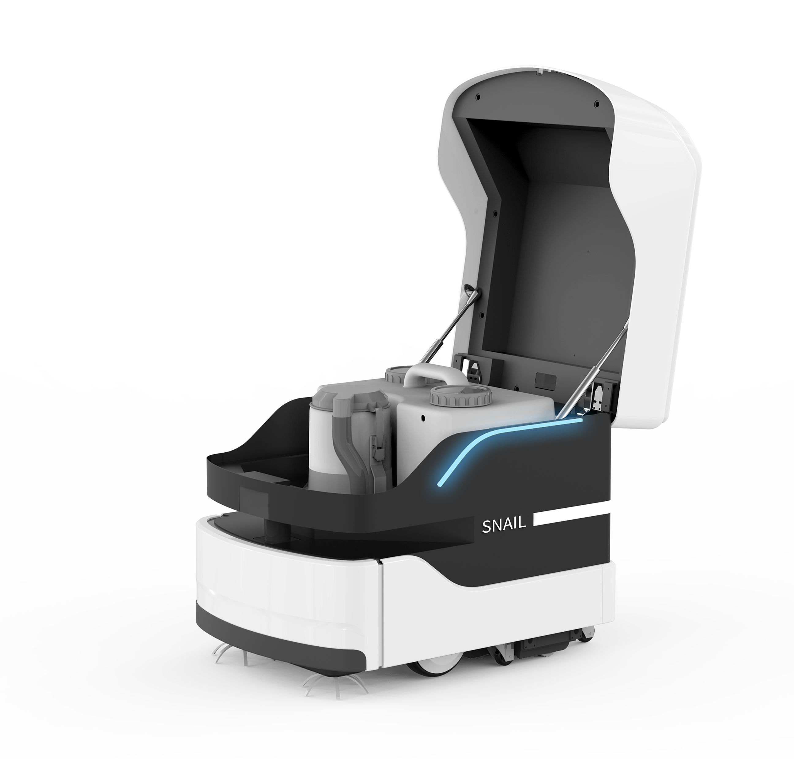
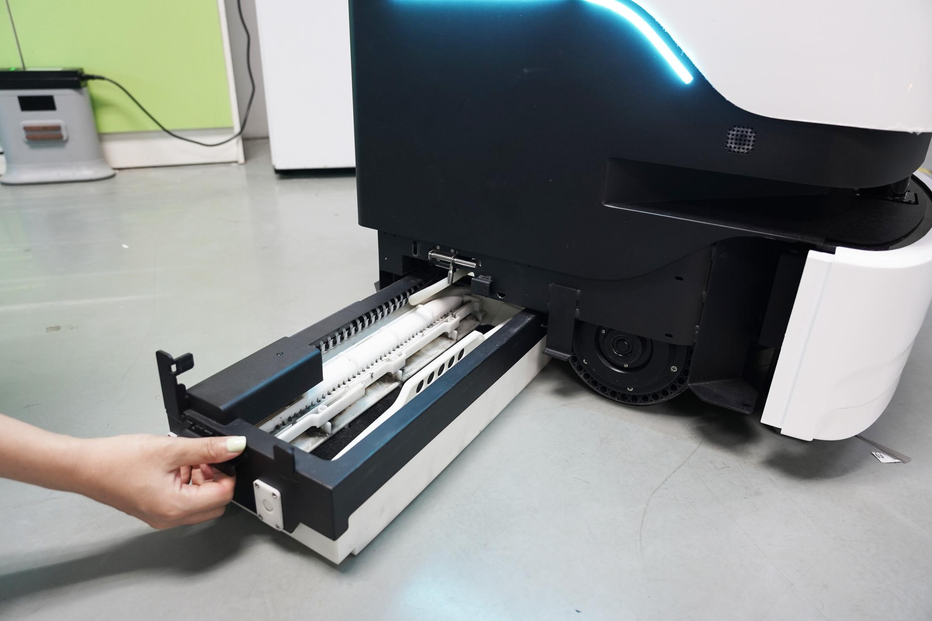
2.4 Convenient maintenance
method
Pull-out type mopping module design
1. Open the lid and automatically turn off the UV lamp, and the recovery tank can be quickly taken out
2. Quick disassembly and assembly of the dust box structure makes garbage disposal easier
3. Pull-out mopping module design makes maintenance and cleaning easier
Water tank
Vacuum box
Lidar
Mopping module
Side brush

Slide 11
2.5 Convenient maintenance method
Remote intelligent control
The cloud service platform is deployed remotely, and the map is constructed by entering the IP address of the robot to view the operating data
Intelligent reminder
After the robot runs for a period of time, it will automatically remind to clean up the robot’s rollers, sewage tank, and dust box
Ground-friendly mopping
Using special polymer materials, mopping and vacuuming will not damage the ground
40,000㎡ large area navigation map
Supports 40,000-square-meter large scene mapping to meet the needs of a variety of complex scenes

Slide 12
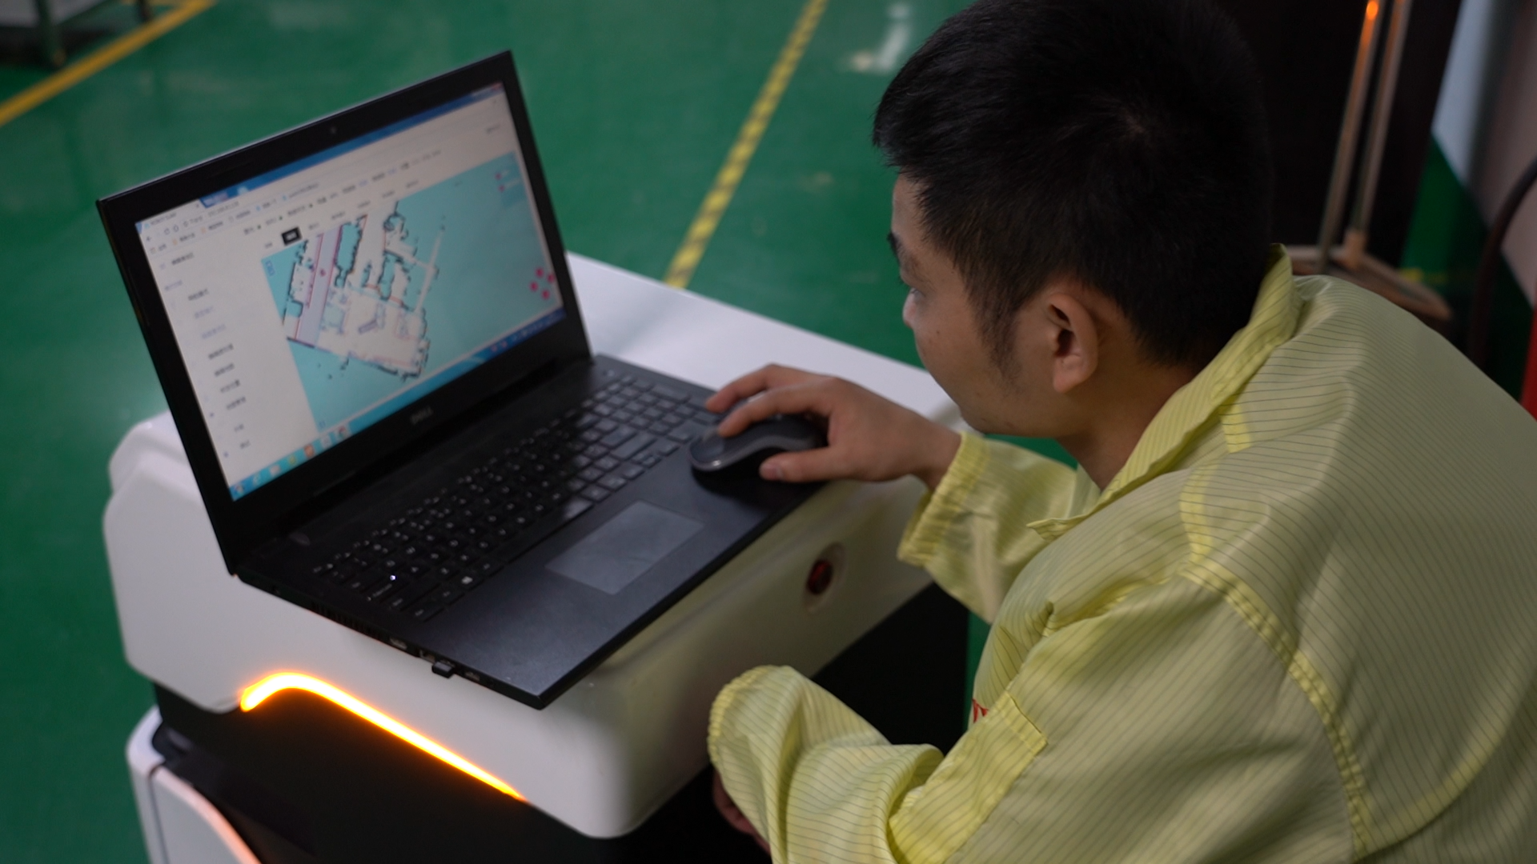
2.6 Operation steps
Connect to the network, make the cleaning robot and the computer in the same local area network, enter the IP address, and log in to the background of the robot operation
1
2
Turn on the mapping mode, remotely control the robot to walk, recognize the surrounding environment, and build a navigation map
3
Lidar accurately measures the distance, observes the positioning status of the robot in real time, and checks whether the positioning coordinates are accurate
4
Edit maps, build virtual walls, customize cleaning areas, and robots automatically perform mopping tasks
5
When performing cross-region mopping tasks, the robots must be on the same map and on the same floor
Build a navigation map
6
Log in to the background address of the robot, you can view the robot running data, power, mileage, location and other information, easy to operate

Slide 13
2.7 Product commercial value
Value
Effectiveness
Reduce labor costs, save expenses, increase benefit ratio, and increase added value
Using robots instead of manual cleaning, high efficiency, high standards, and more thorough cleaning
Business
Value
Brand
Convenient
Use cleaning robots to free your hands, enhance brand image, and increase the sense of science and technology
Regular cleaning, automatic charging, quick-release mopping module, more worry-free cleaning

Slide 14
2.8 Product specifications
Product name | Snail sweeper cleaning robot
Product number | SS-15
Water tank volume | 15L
Cleaning route | “弓”Walking path
Cleaning speed | 0.1~0.5m/s
Type of battery | Lithium iron phosphate, 25Ah/38.4V
Minimum pass width | 900mm
Charging time | 6h
Battery life | 9h
Standby time | 30h
Suction power | 2.3Kpa
Cleaning mode | standard
Way of working | Regular cleaning, manual cleaning
Display size | 7-inch IPS screen (16:9) resolution 1024X600
Rated power of whole machine | 120W
UV lamp power | 16W
Product weight | 100.8KG (Including adapter, charging pile, wooden box packaging)
Product size (L*W*H) | 684mm*500mm*600mm
Snail sweeper cleaning robot
◎ Custom cleaning area
◎ Remote navigation and mapping
◎ Regular cleaning tasks
◎ Automatically generate cleaning route
◎ Automatic return to charging

Slide 15
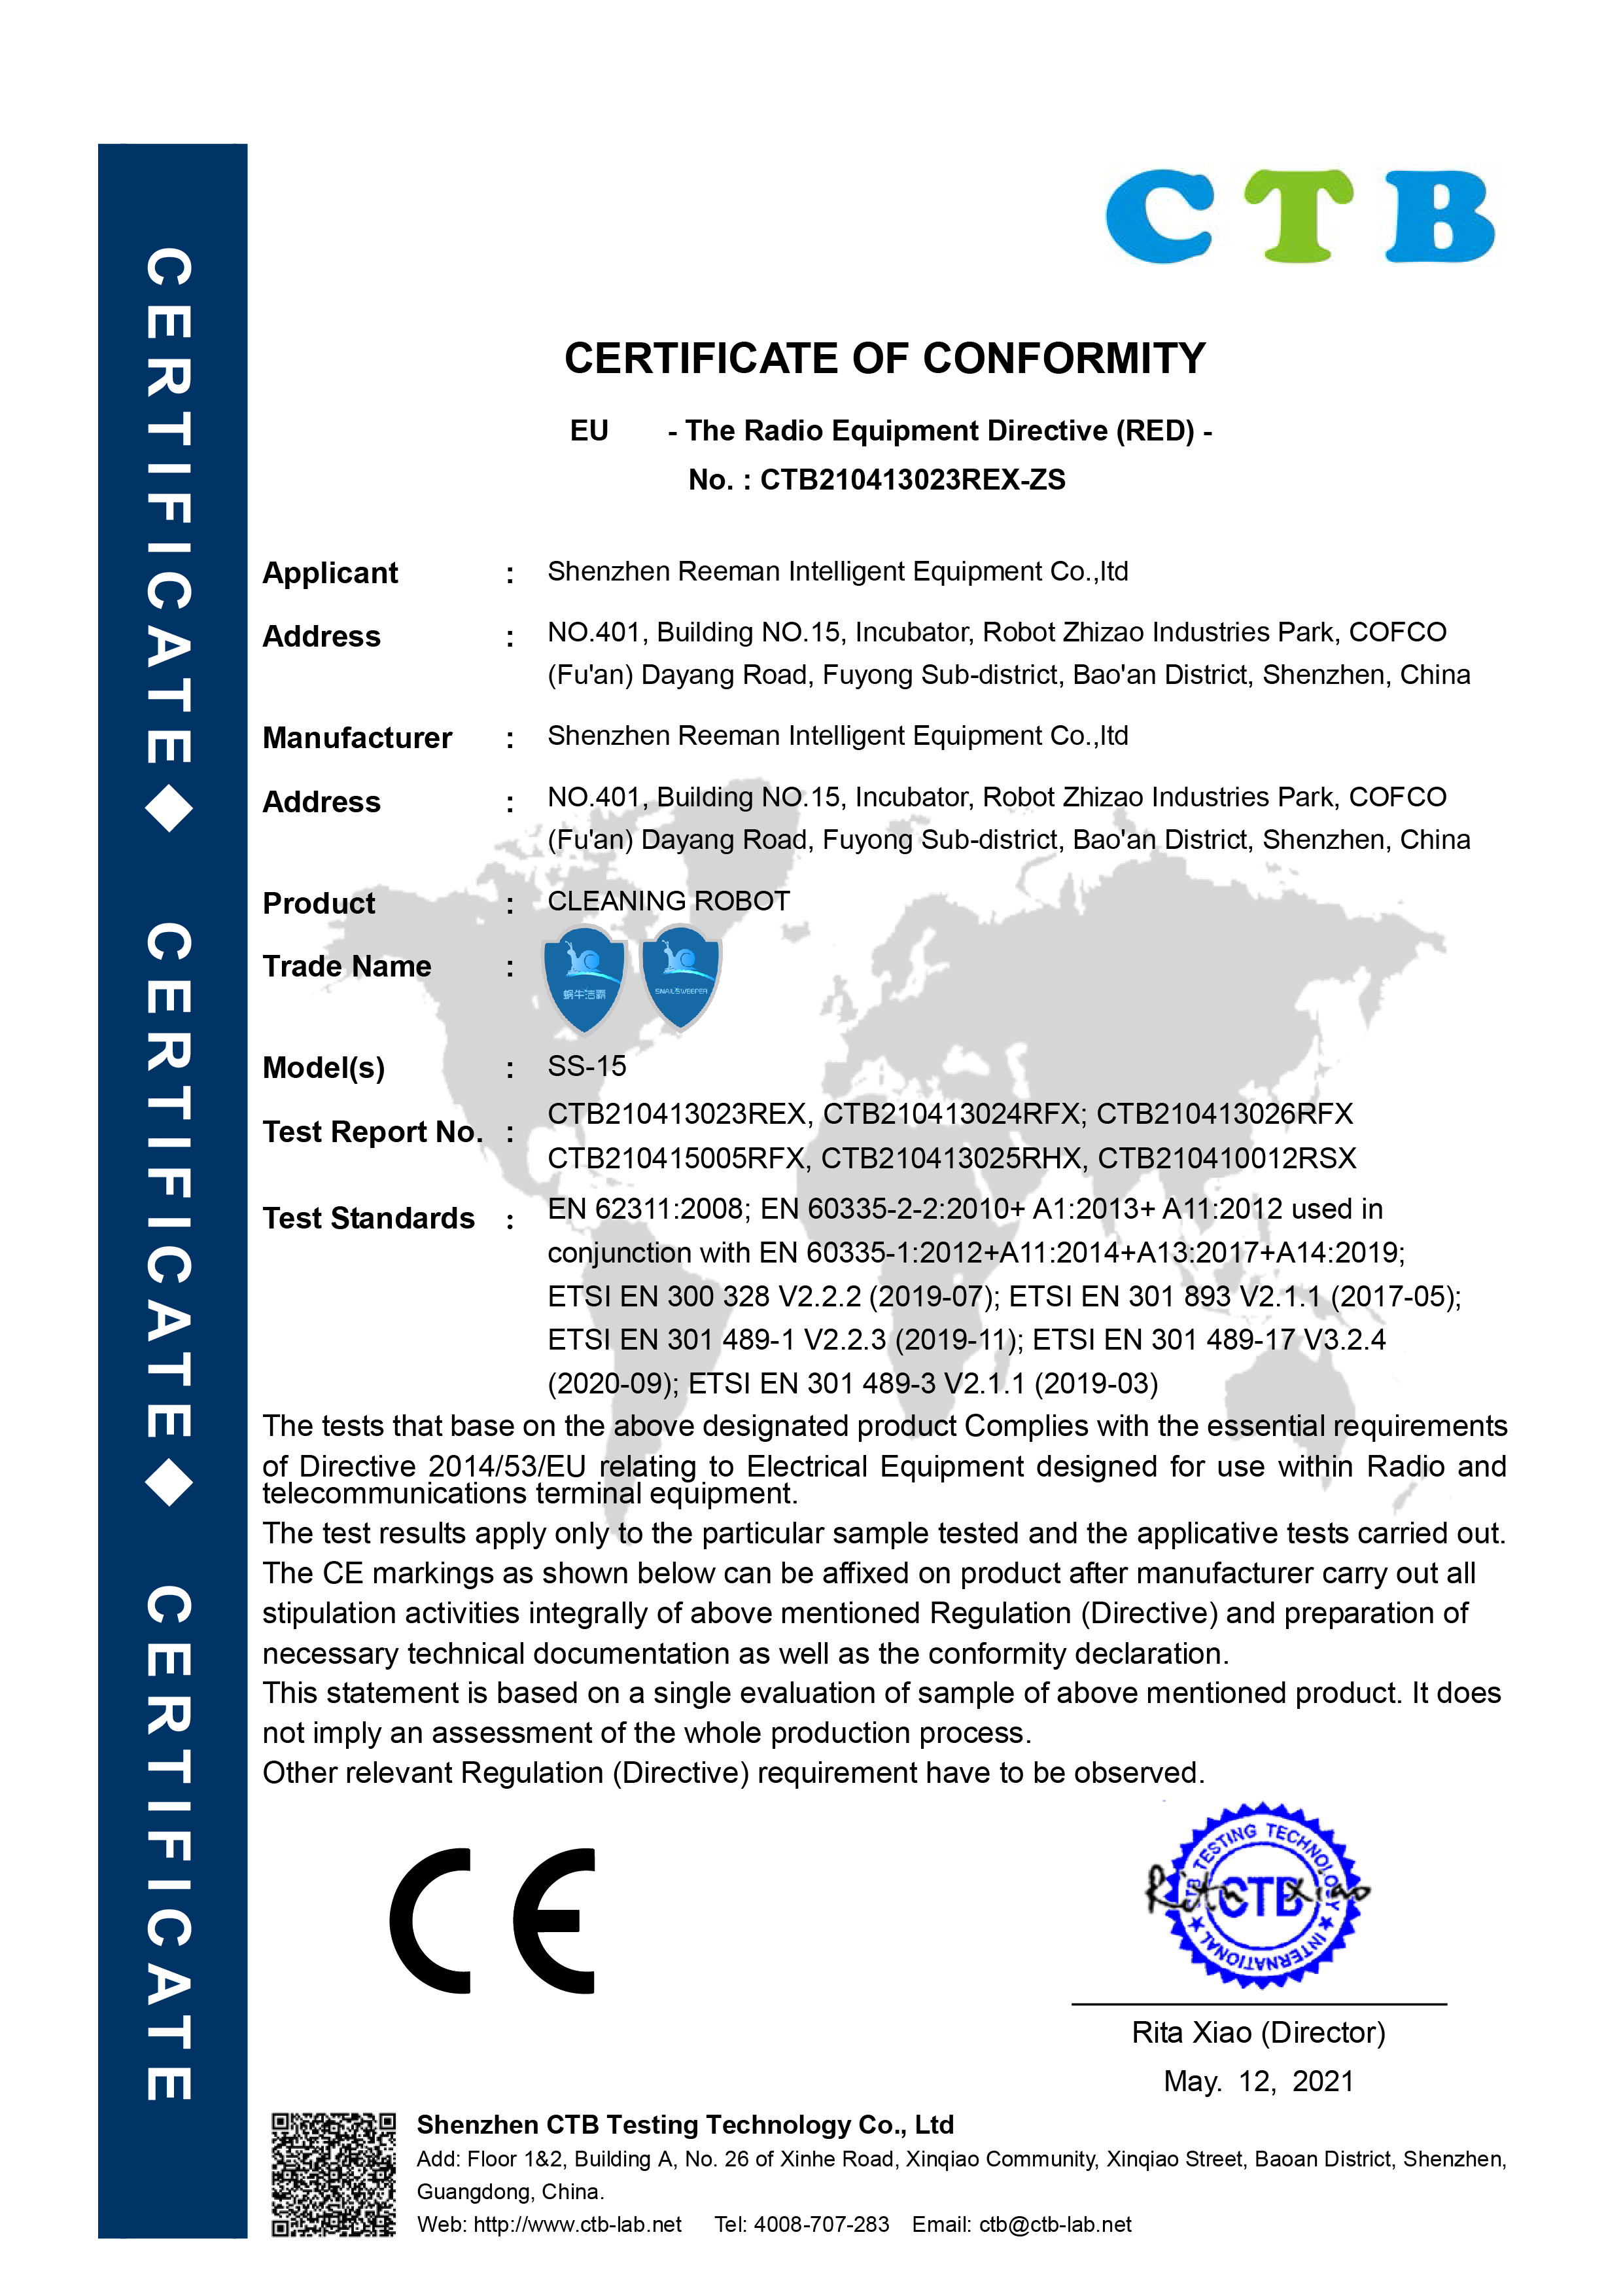
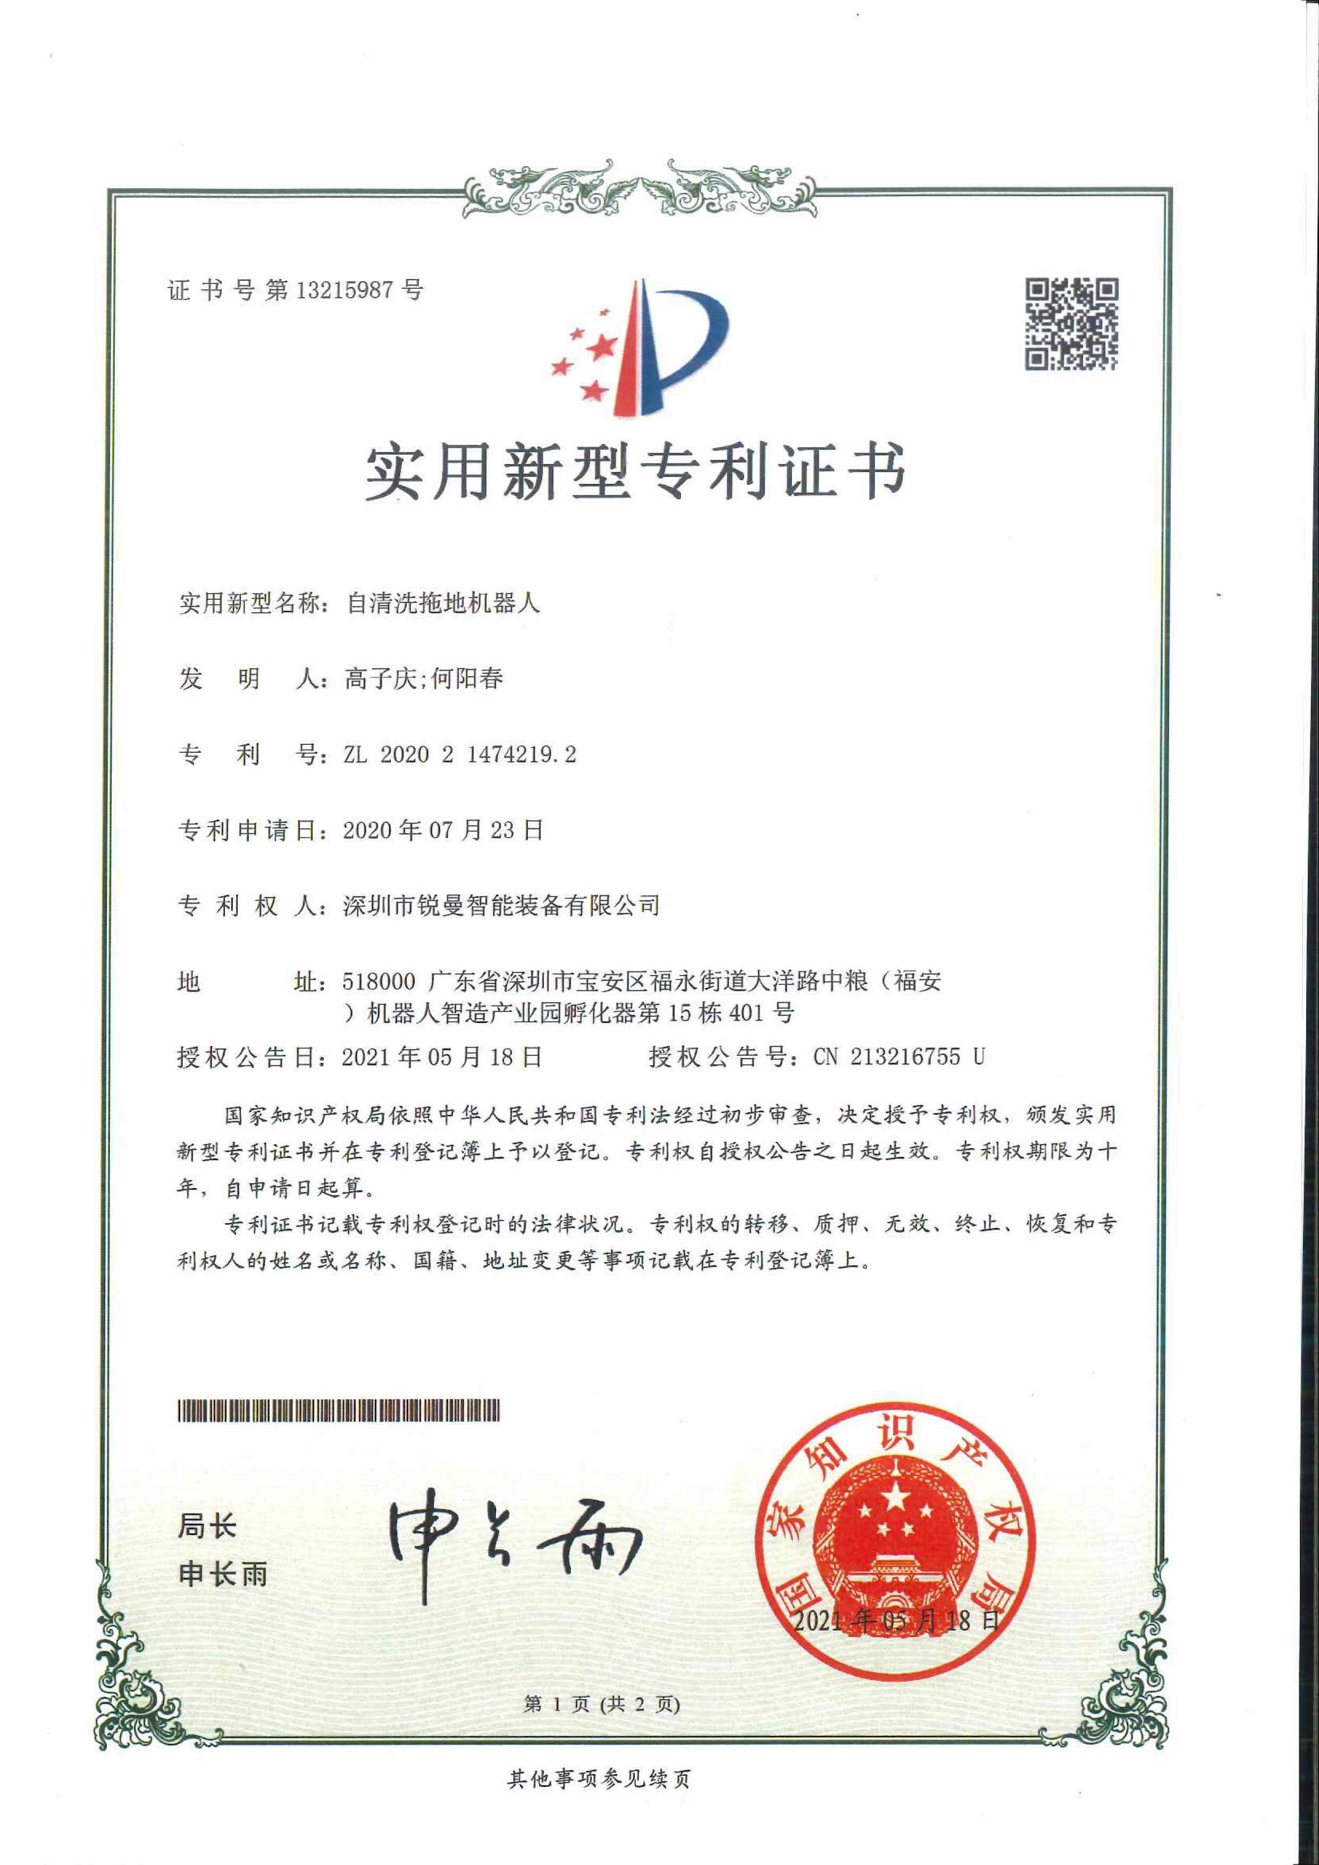
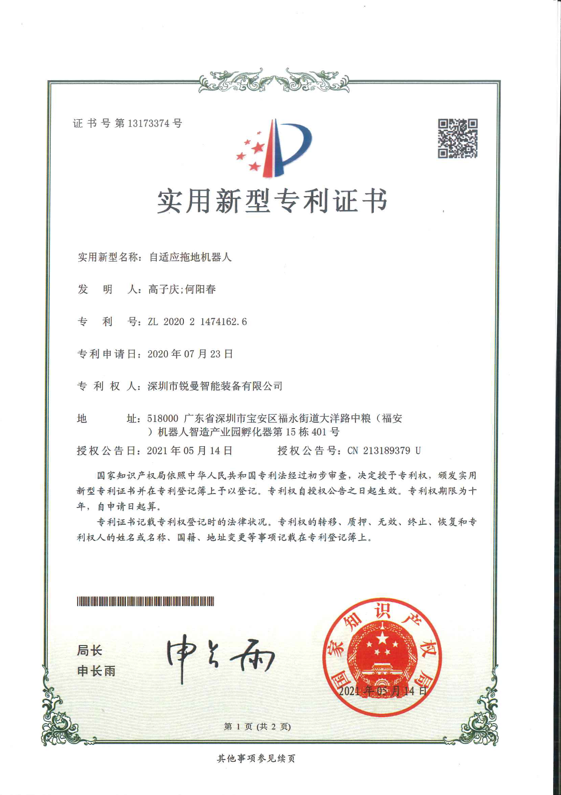
2.9 Product patent & CE certification

Slide 16
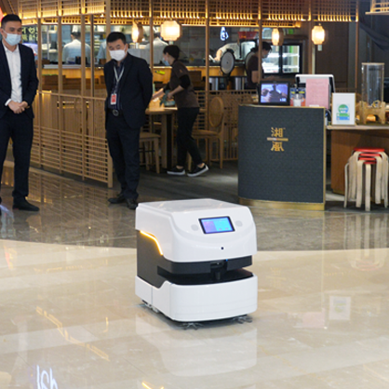
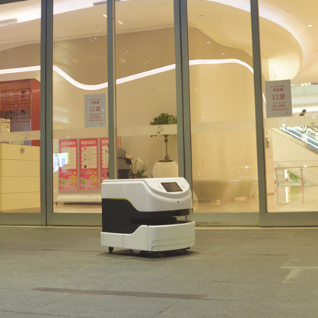
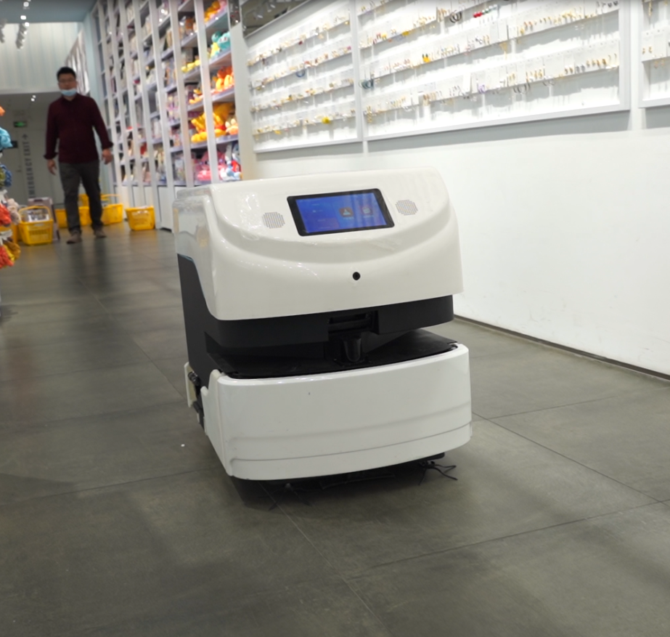
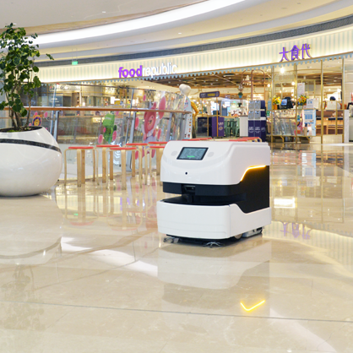
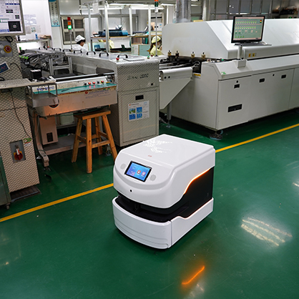
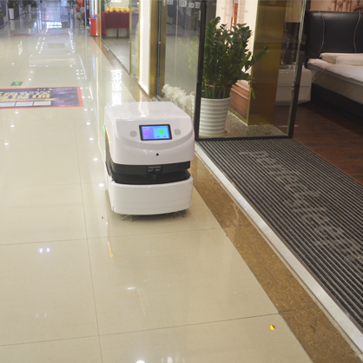
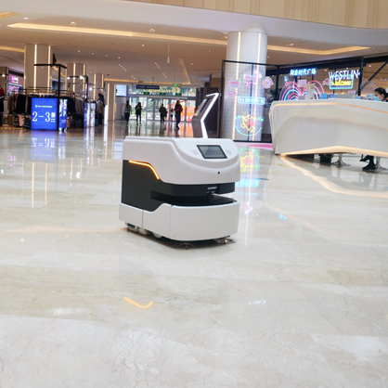
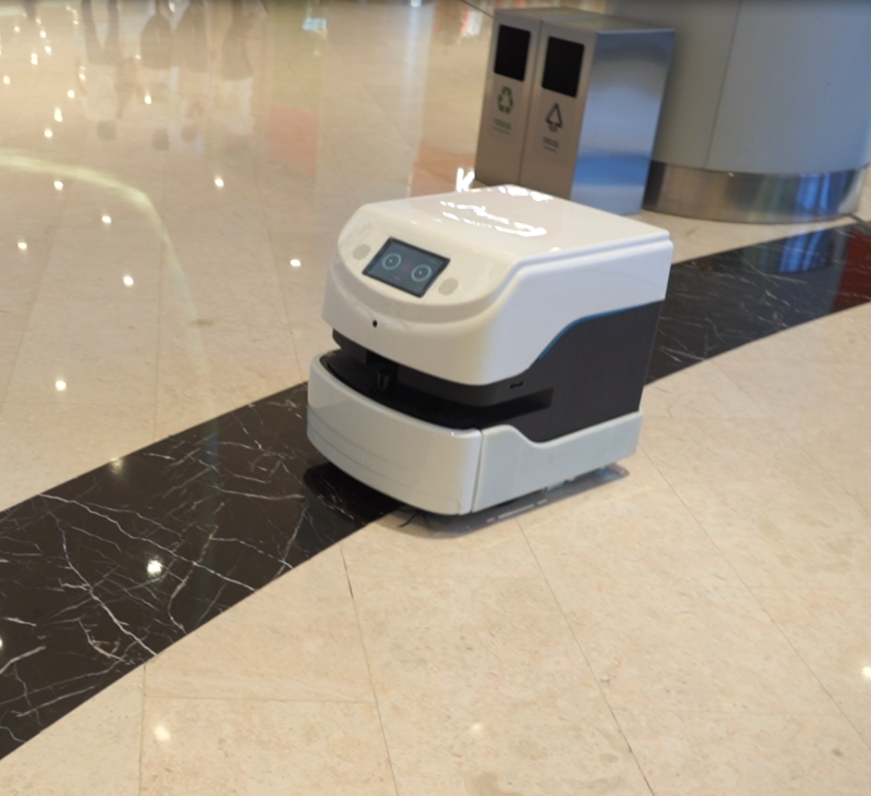
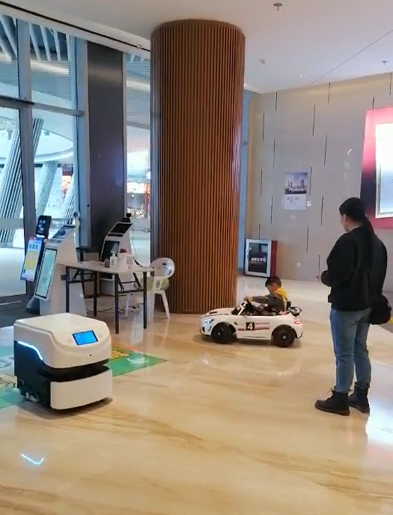
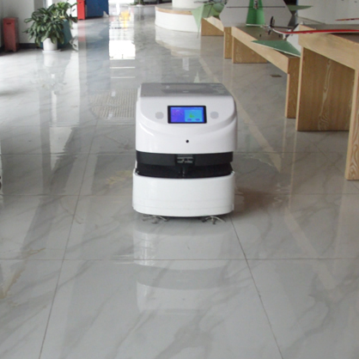
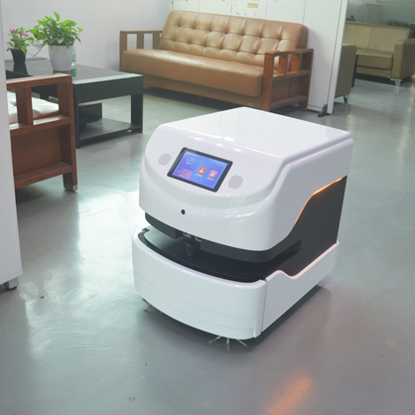
3.1 Case show
restaurant
parking lot
Chain store
supermarket
dust-free workshop
furniture Mall
hotel lobby
office building
Commercial Complex
Exhibition hall
Corporate Office
shopping mall

Slide 17
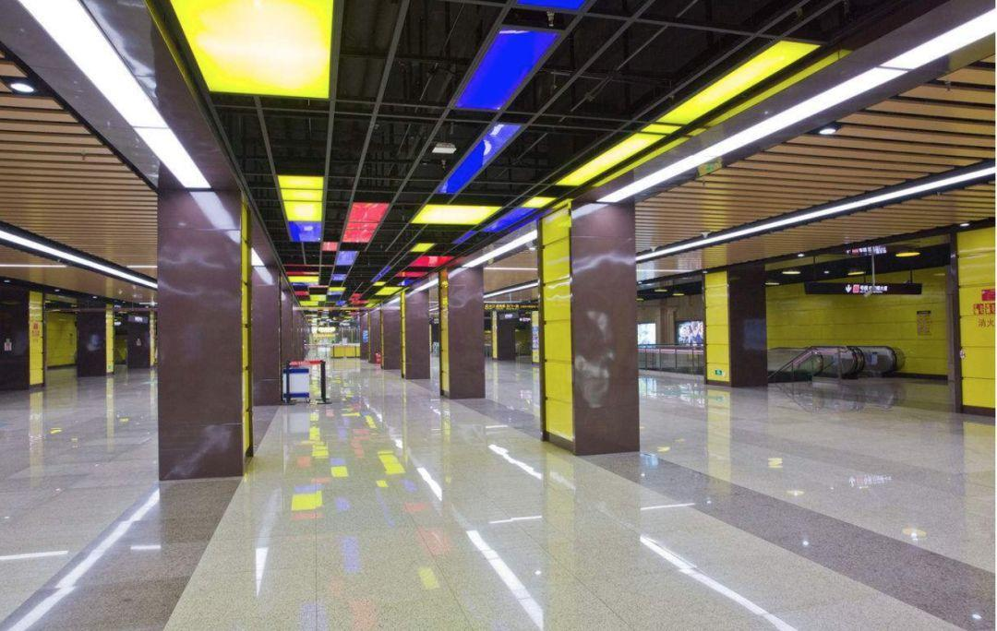
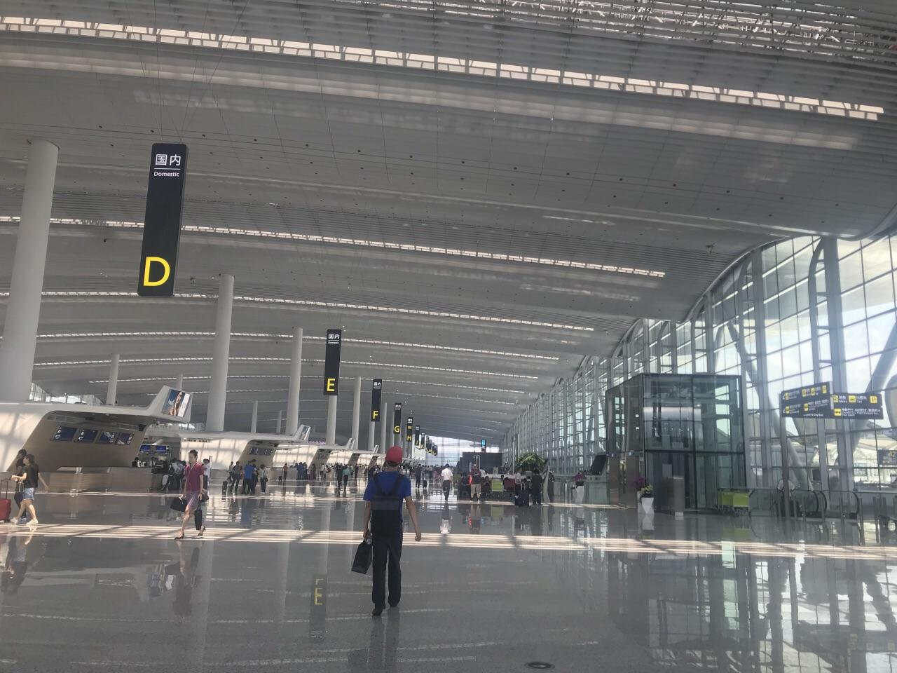
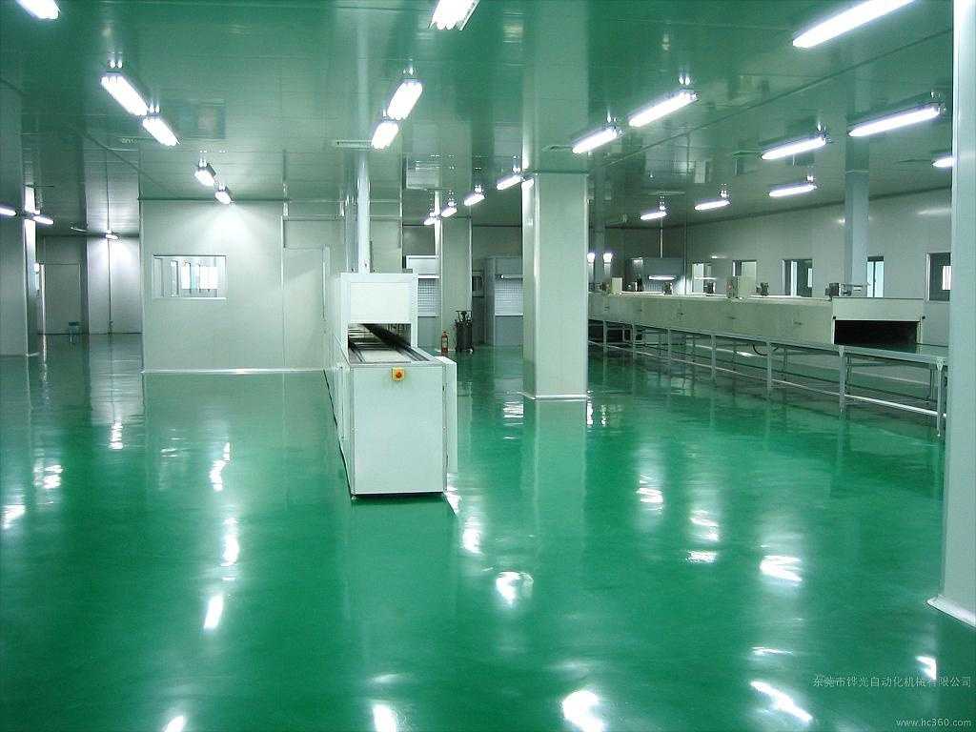
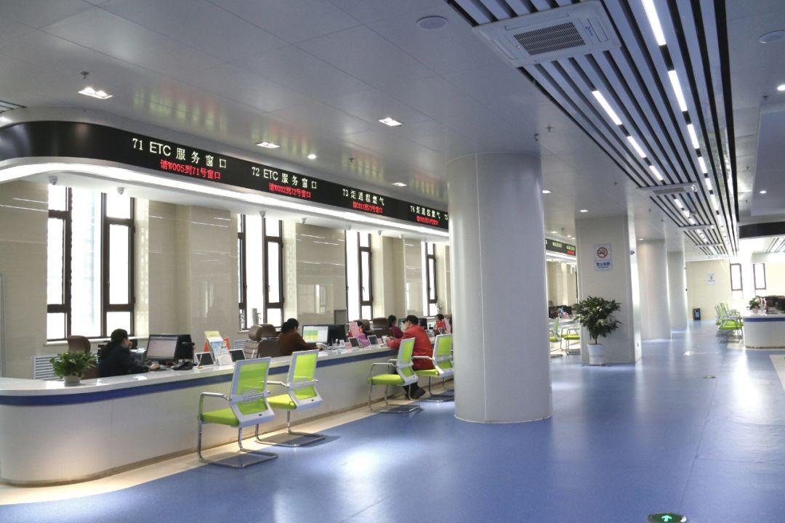
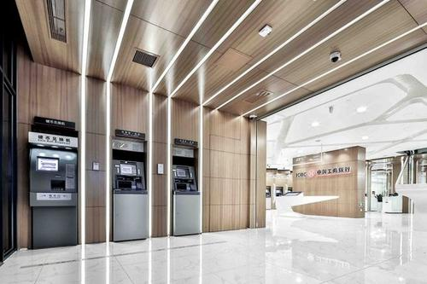
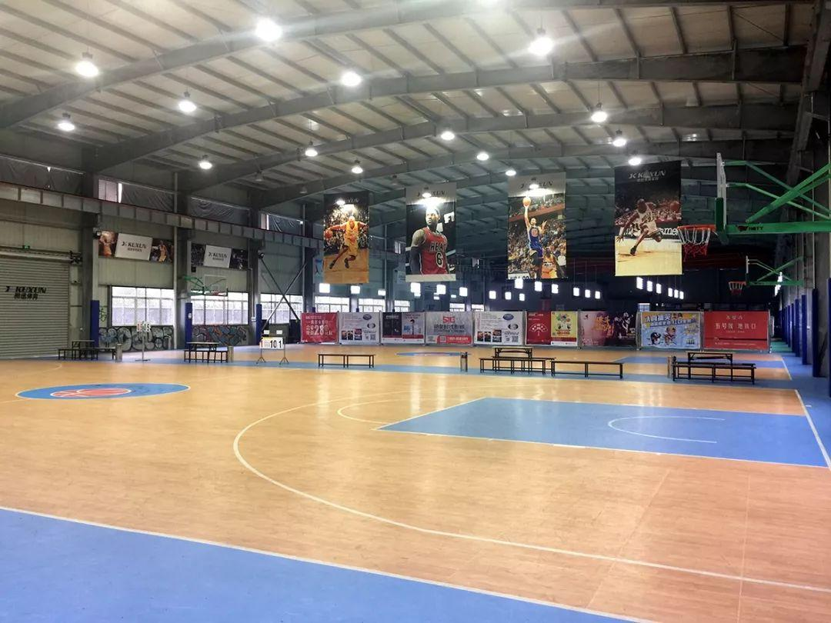
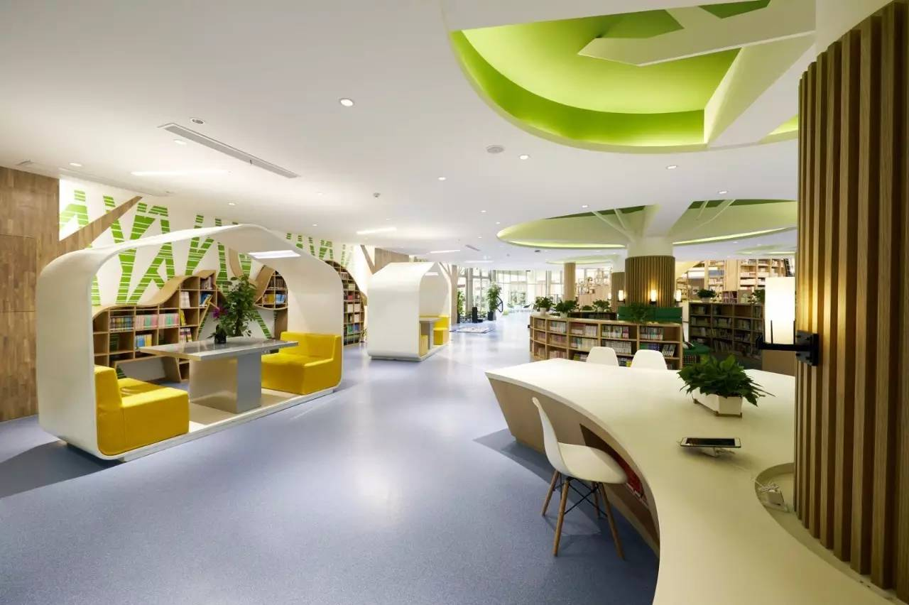
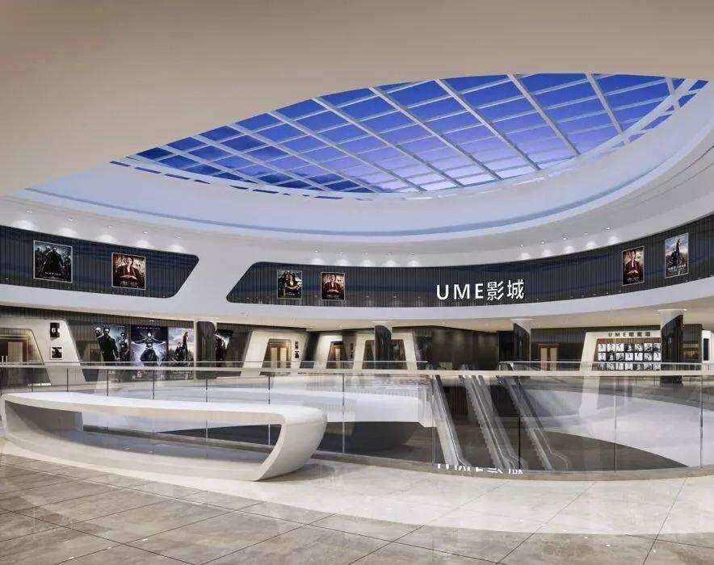
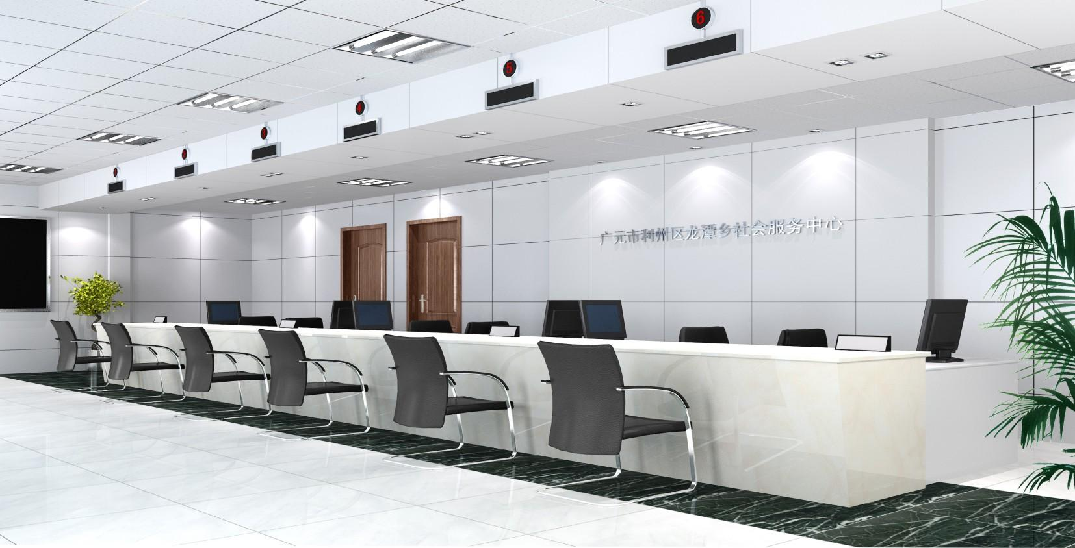
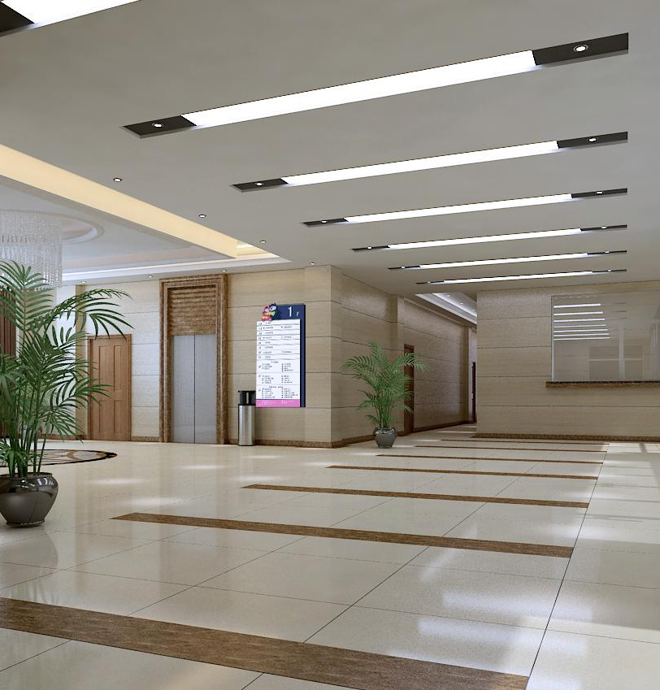
3.2 Applicable scene
Suitable for cleaning large and medium-sized indoor public places
Subway stations, high-speed rail stations, airports, customs ports
Supermarkets, hotels, restaurants, commercial centers
Government affairs hall, factory workshop, bank, office building
Schools, gymnasiums, libraries, museums, science and technology museums
Convention and Exhibition Center, Smart Exhibition Hall, Auto City, Furniture City
Cinemas, hospitals, nursing homes, welfare homes
Floor material requirements: marble, PVC, wood floor, polyurethane, granite, terrazzo, cement floor, epoxy resin, ceramic tile and other hard floors

Slide 18
Thank you for watching
Reeman Brand Department
www.reeman.cn
Shenzhen Reeman Intelligent Equipment Co.,ltd
TEL：0755-86239429 E-mail：sales@reeman.cn Web：www.reeman.cn 1688 web：https://reeman.1688.com
Alibaba International Station：https://reeman.en.alibaba.com Alibaba International Station：https://sweeper1.en.alibaba.com
Add：NO.401, Building NO.15, Incubator,Robot Zhizao Industries Park, COFCO (Fu'an) Dayang Road, Fuyong Sub-district, Bao'an District, Shenzhen

